Slide 1


PGP In Data Science and Engineering
Exploratory Data Analysis – Mini project
By-Ankit Chatterjee

Slide 2
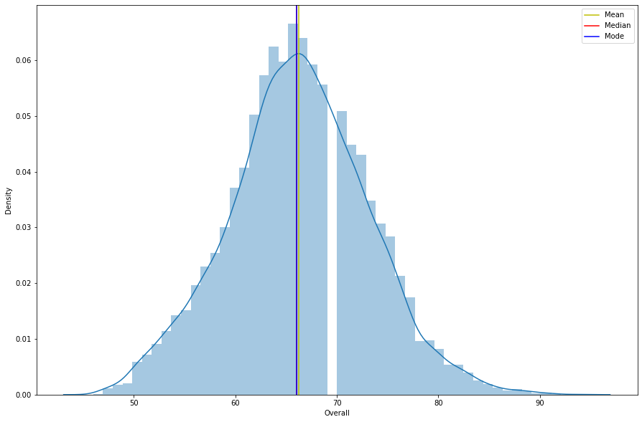
Analysis The Distribution Plot
Step 1:
Data Preprocessing :
1. Cleaning the data from csv file ‘fifa.csv’.
2. we have done null value imputation .
Step2:
Exploratory Analysis:
1. After null value imputation we have done a graphical representation.
2. From the graph we can say that the distribution plot is a normally distributed

Slide 3
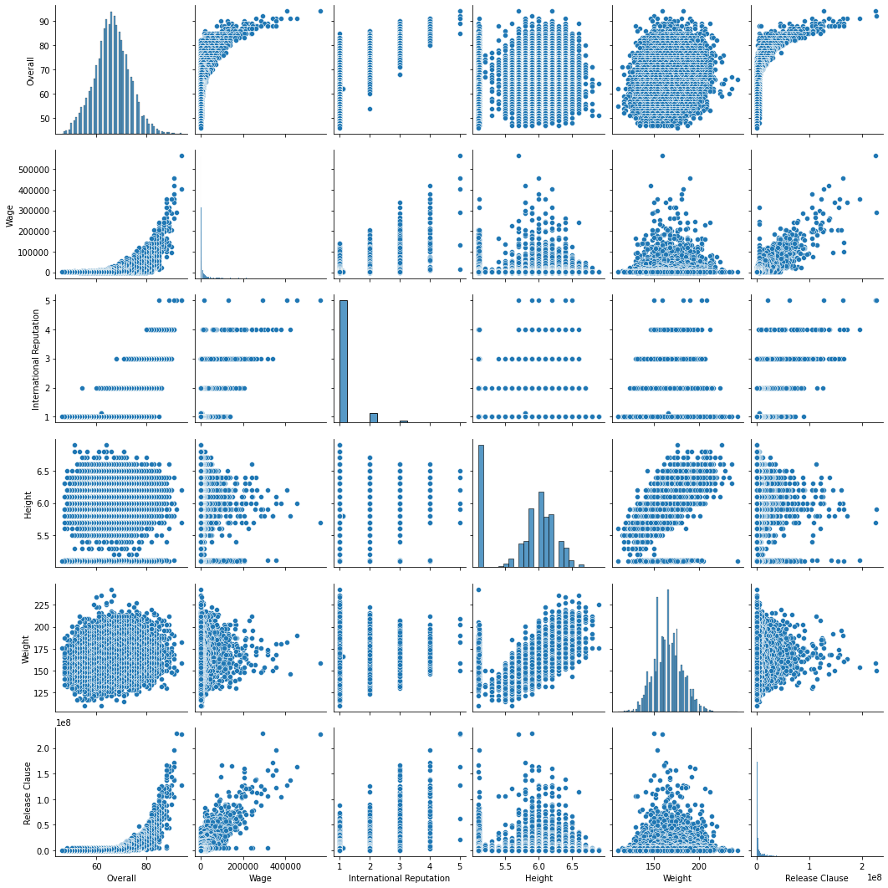
Pair plot
From pair plot we easily find several distribution in one plot.
So ,We have done analysis from this column Overall, Value, Wage, International Reputation, Height, Weight, Release Clause.

Slide 4
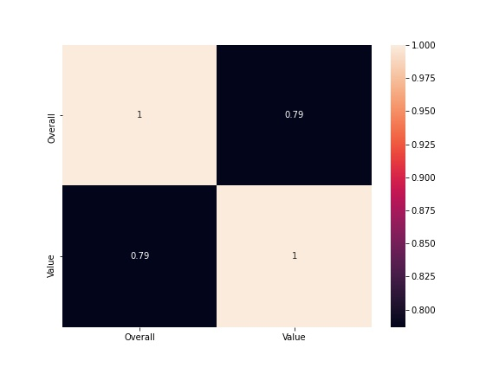
Heat map
From the heat map we have done analysis correlation between two column overall and value

